Slide 1


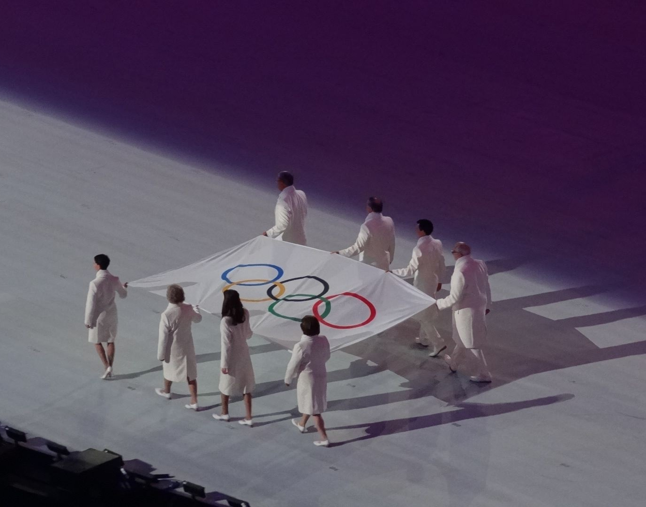
Comparative Analysis on 120 years of Olympic History using Machine Learning Algorithm
SUMMER TRAINING PROJECT ON
SUBMITTED TO:
Mr. Prateek Gupta
(ShapeMySkills)
Submitted by:
Name: Japneet Kaur
Roll no.: 04990302021
Institute of innovation in technology & management

Slide 2
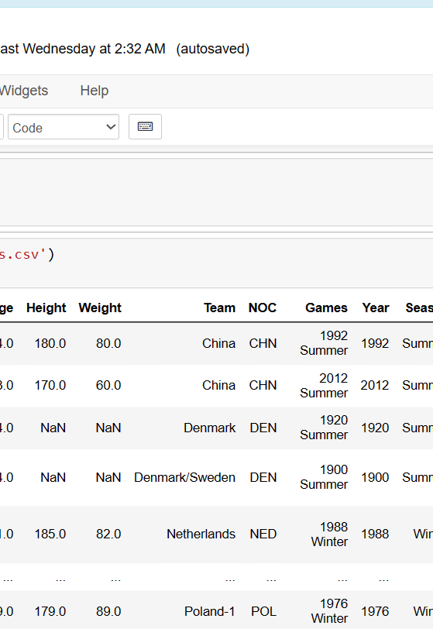
Objective
The primary objective of this project is to utilize advanced data science techniques to extract meaningful insights from a comprehensive dataset spanning over a century of Olympic games.
By employing various machine learning algorithms, we aim to uncover hidden patterns, trends, and correlations within the data.

Slide 3
Python: The Engine of Analysis
Python, a dynamic and versatile programming language, serves as our primary vehicle for data manipulation and analysis. Its rich ecosystem of libraries - including
Pandas for data handling,
Matplotlib for visualization, and
NumPy for numerical operations
empowers us to seamlessly process and interpret the vast Olympic dataset.
Machine Learning: Unveiling Patterns
Machine Learning, a branch of artificial intelligence, forms the cornerstone of our analytical journey. At its essence, machine learning enables us to build models that can learn from historical data and make predictions or decisions without being explicitly programmed.

Slide 4
Analysis Process
Data gathering
Data is gathered from Kaggle.
data exploration
Data cleaning
Data is cleaned and null values are handled
Constructing charts and dashboards
Applying machine learning algorithm.

Slide 5
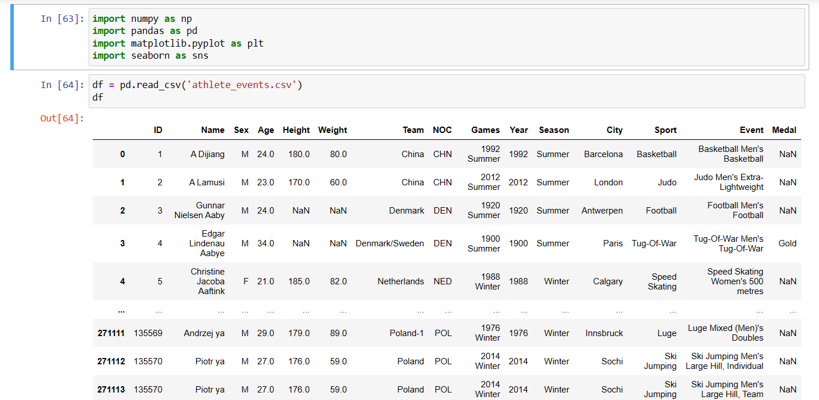
DATASET

Slide 6
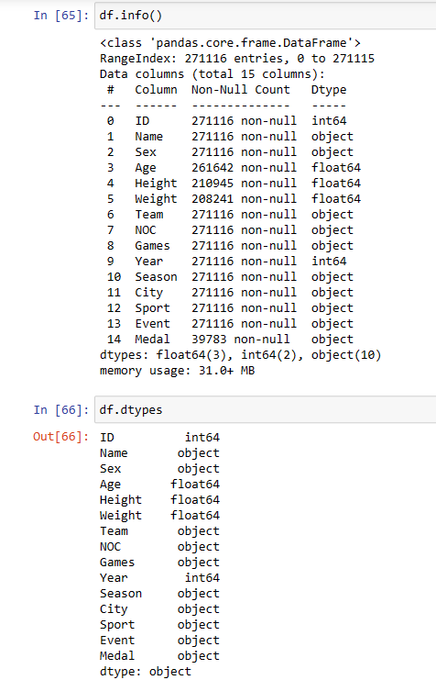
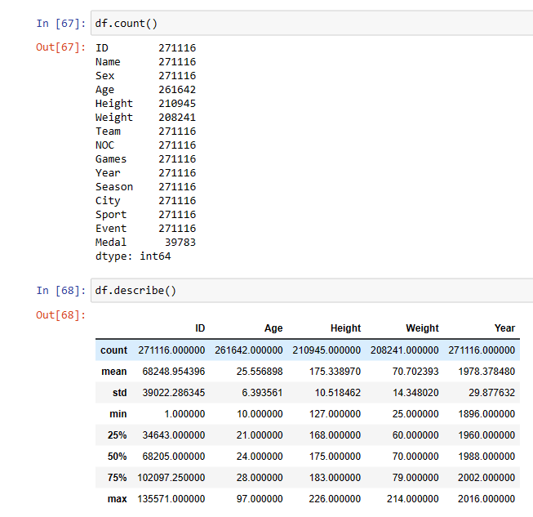
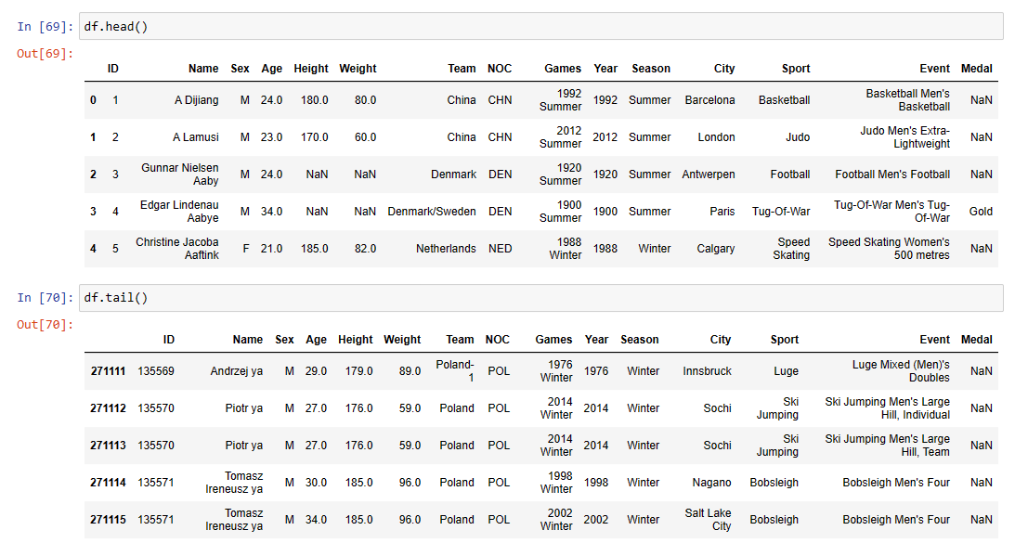
Data Exploration

Slide 7
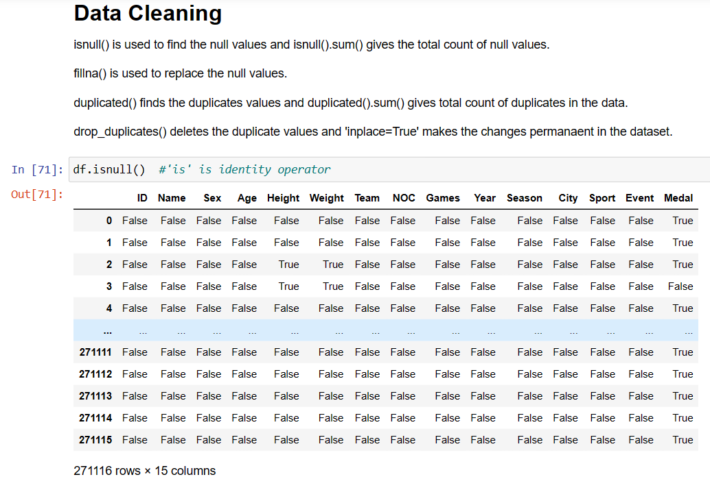
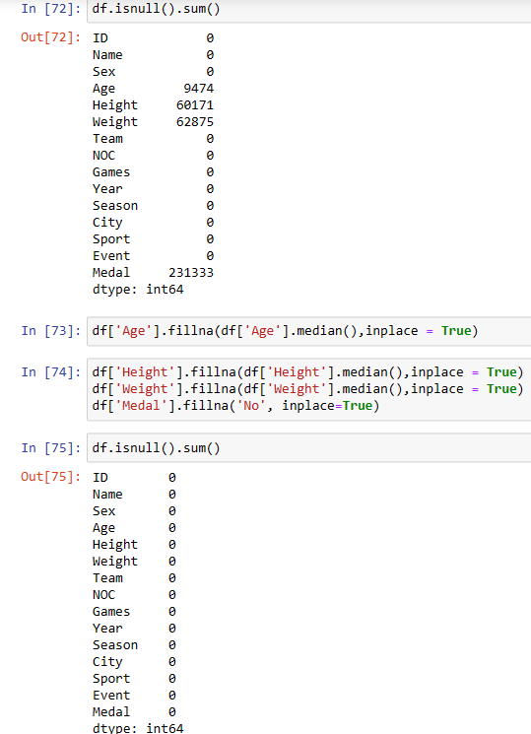
Data Cleaning

Slide 8
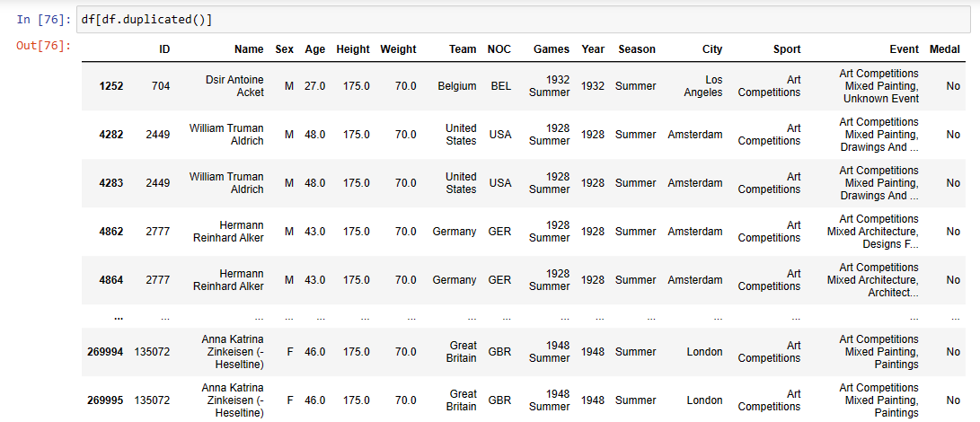
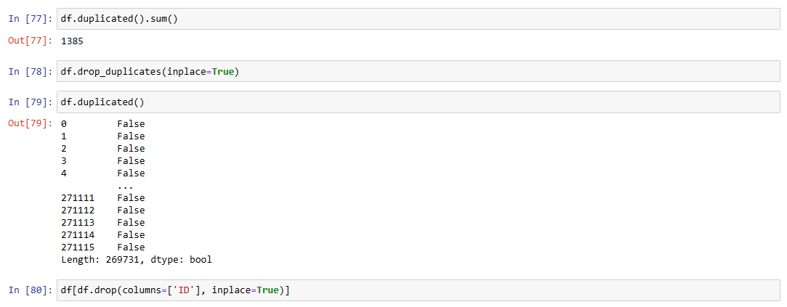
Data Cleaning

Slide 9
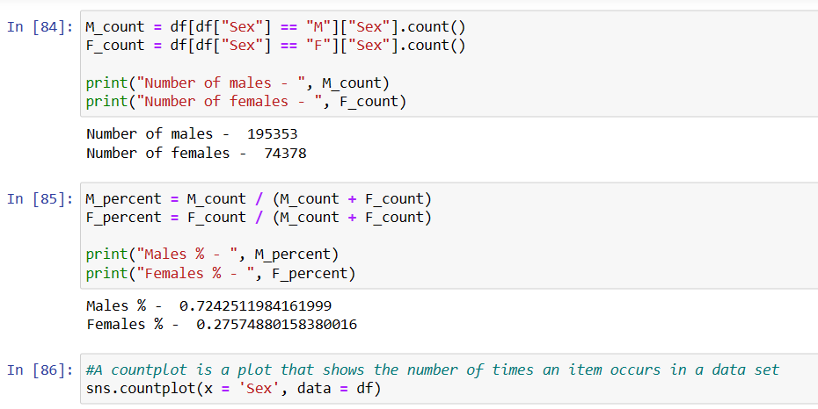
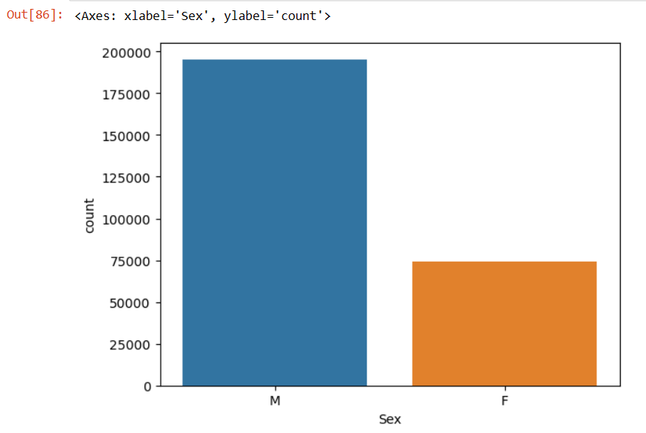
Data Visualization
Matplotlib is a comprehensive Python library for creating static, animated & interactive visualizations.

Slide 10
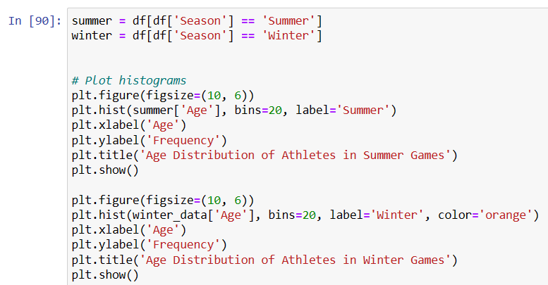
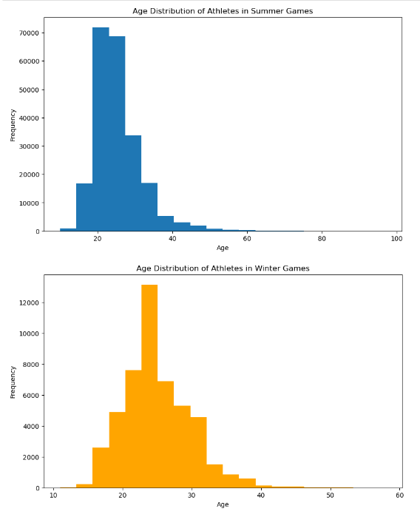
Data Visualization

Slide 11
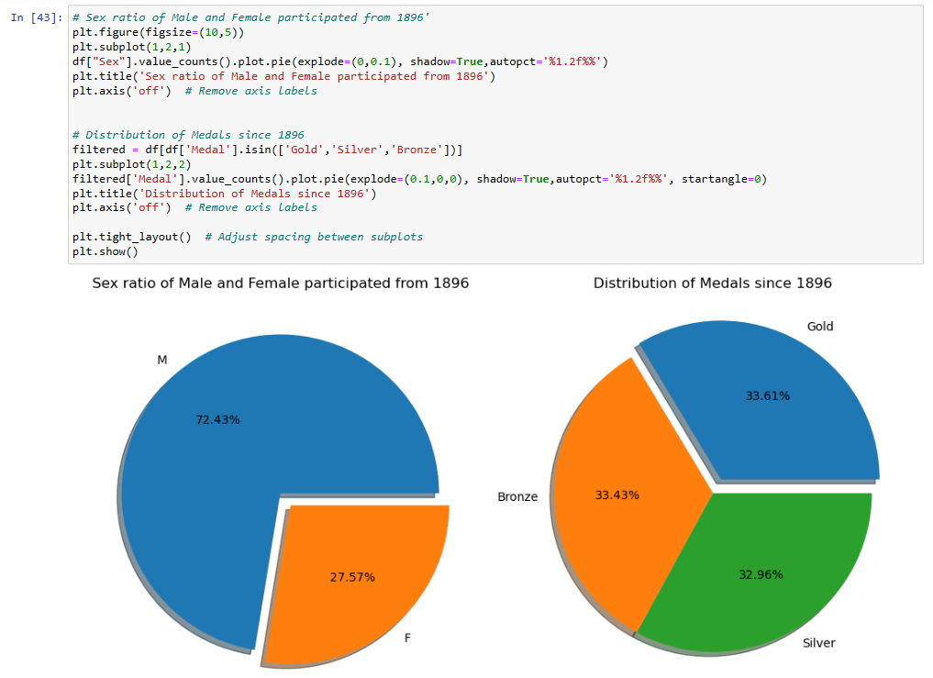
Data Visualization

Slide 12

TABLEAU
A software for Data Visualization
Tableau is a powerful and fastest growing data visualization tool used in the Business Intelligence Industry.
Data Visualization
Data Collaboration
Data visualization is the graphical representation of information and data.
Data collaboration is the act of gathering and connecting data from various sources
Real-time data analysis
Business Intelligence
Real-time data analysis is a process by which the data is analyzed in real-time or as it's being collected.
Business intelligence (BI) is a technology-driven process for analyzing data and delivering actionable information.

Slide 13
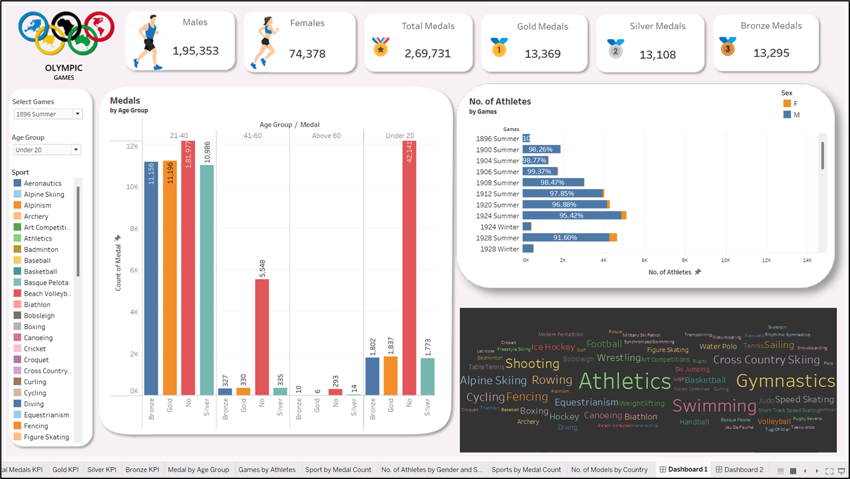
DASHBOARD 1

Slide 14
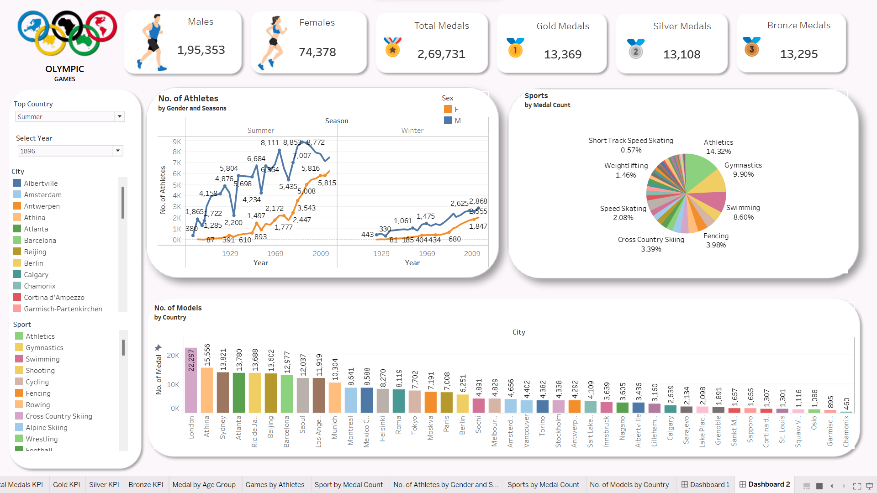
DASHBOARD 2

Slide 15
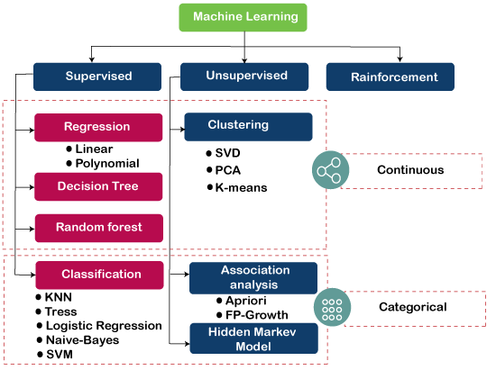

Slide 16
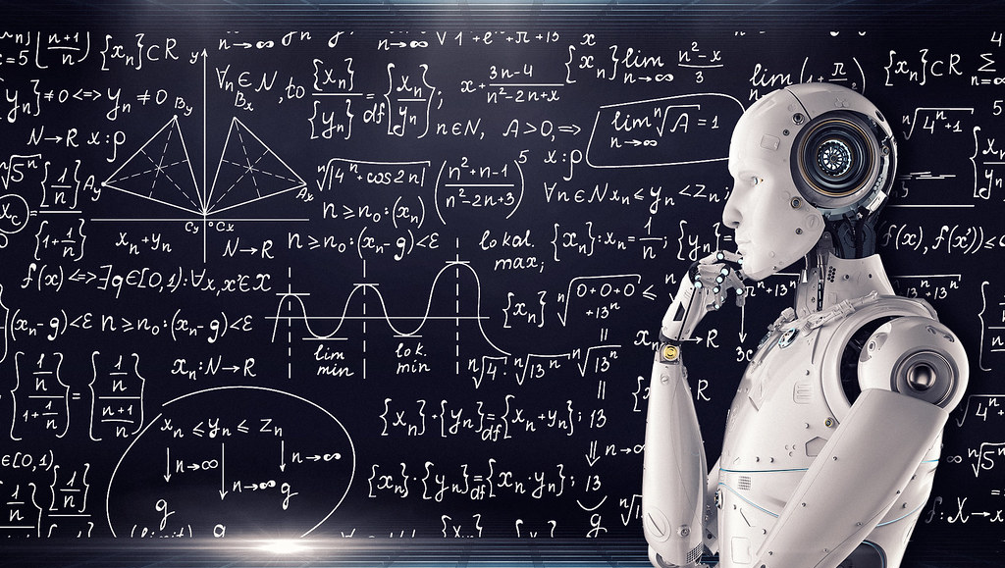
Machine Learning Algorithms
The analysis employs a spectrum of machine learning algorithms, each meticulously chosen to answer specific questions and explore unique facets of Olympic history:
Logistic Regression:
Predicting Total no. of medals to be distributed based on years using logistic Regression

Slide 17
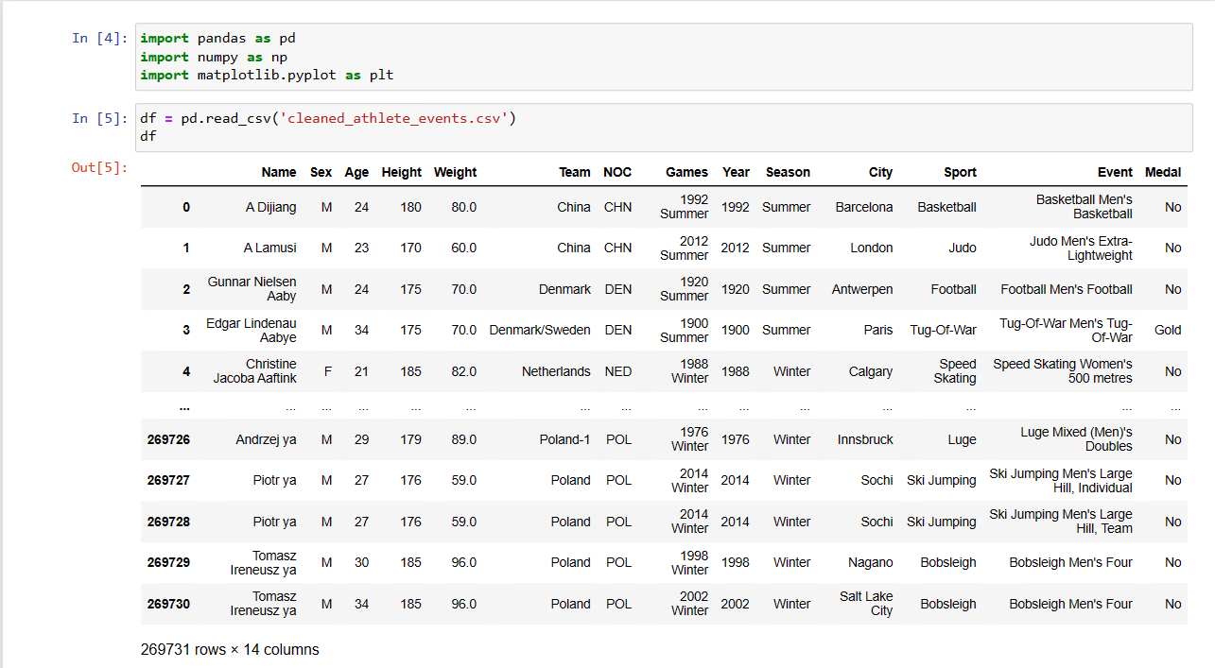
Logistic regression
Predicting Total no. of medals to be distributed based on years using Logistic Regression

Slide 18
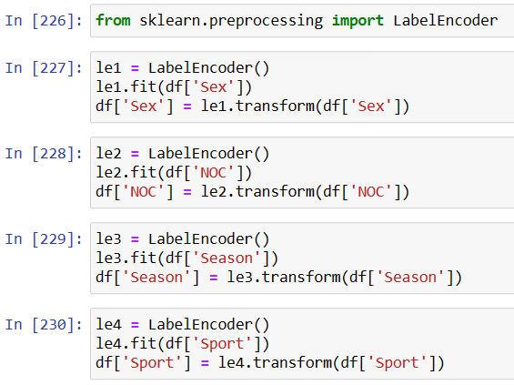
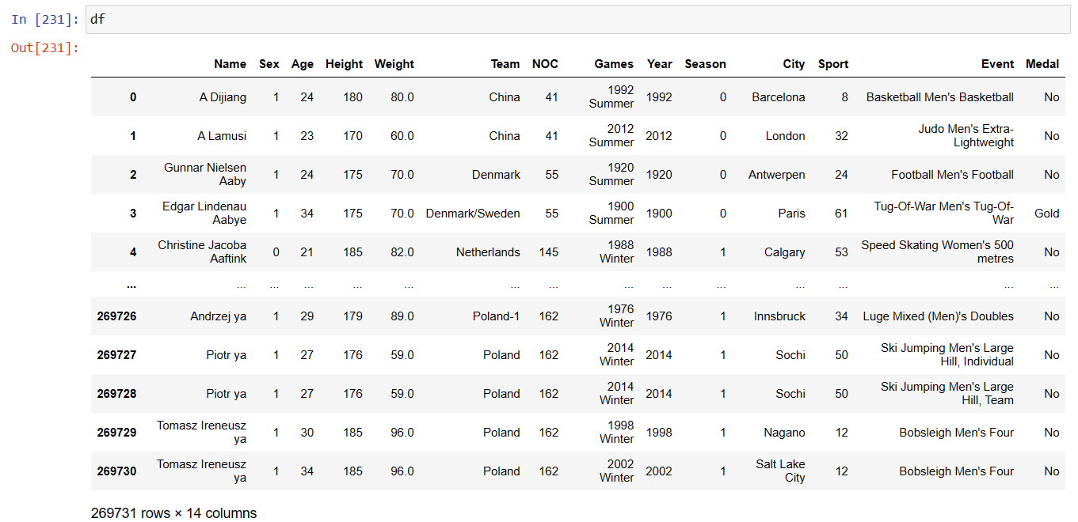
Logistic regression
DATA PREPROCESSING

Slide 19
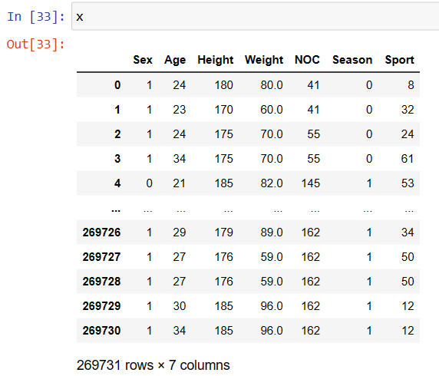
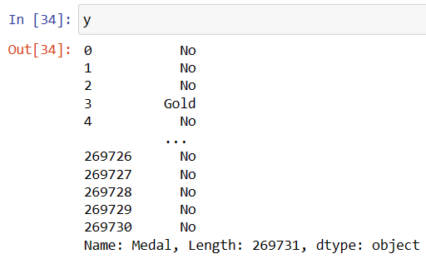
Logistic regression
CATEGORISING AND SLICING

Slide 20
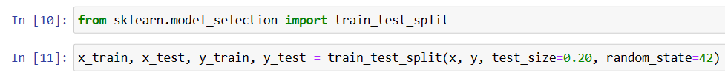
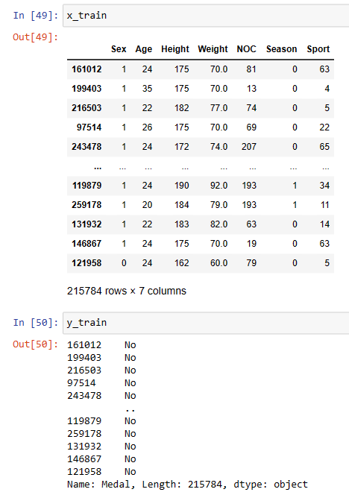
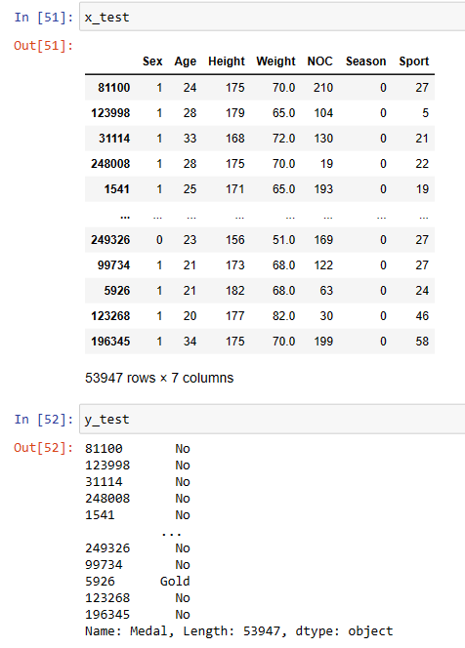
Logistic regression
TRAIN TEST SPLIT

Slide 21
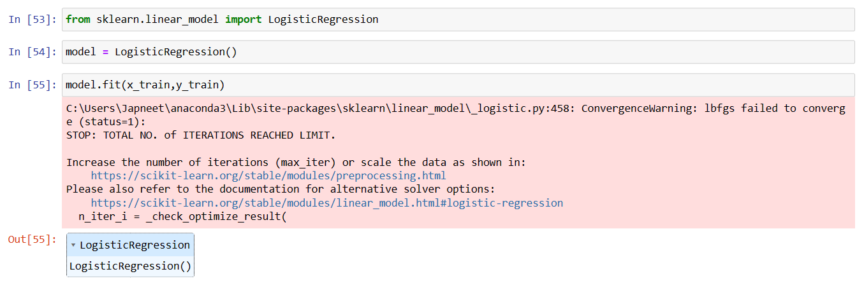
Logistic regression
APPLYING LOGISTIC REGRESSION

Slide 22
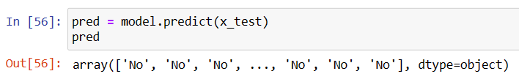
Logistic regression
PREDICTION
Our Model predicts that whether/which Medal will be won by considering the Sex, Age, Height, Weight, NOC, Season and Sport that the player plays.

Slide 23
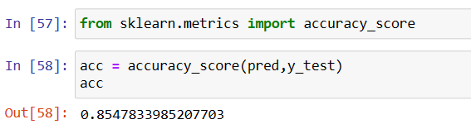
Logistic regression
CALCULATING ACCURACY
Results Predicted by the Model are 85.47% Accurate

Slide 24
COMPARISON OF ACCURACY
(Logistic Regression)
TEST_STATE | RANDOM_STATE | ACCURACY
50 | 42 | 85.26%
30 | 21 | 85.22%
20 | 90 | 85.25%
20 | 42 | 85.47%

Slide 25
COMPARISON OF ACCURACY
(Decision Tree Classifier)
TEST_STATE | RANDOM_STATE | ACCURACY
50 | 42 | 79.04%
30 | 21 | 79.90%
20 | 90 | 80.14%
20 | 42 | 80.41%

Slide 26
COMPARISON OF ACCURACY
(Random Forest Classifier)
TEST_STATE | RANDOM_STATE | ACCURACY
50 | 42 | 84.29%
30 | 21 | 84.21%
20 | 90 | 84.25%
20 | 42 | 84.45%

Slide 27
COMPARISON FOR BEST MODEL WITH MOST ACCURACY
MODEL USED | TEST_SIZE | RANDOM_STATE | ACCURACY
Logistic Regression | 0.20 | 42 | 85.47%
Decision Table Classifier | 0.20 | 42 | 80.41%
Random Forest Classifier | 0.20 | 42 | 84.45%

Slide 28
FUTURE SCOPE
Medal Analysis and Trends:
Study the distribution of medals across countries and over time.
Analyze changes in medal counts based on geopolitical events and shifts in power.
Investigate trends in medal counts across different sports and disciplines.
Athlete Performance:
Study the evolution of athletic performance, including records broken and advancements in training and equipment.
Investigate factors contributing to improvements in performance, such as nutrition, sports science, and training methods.

Slide 29
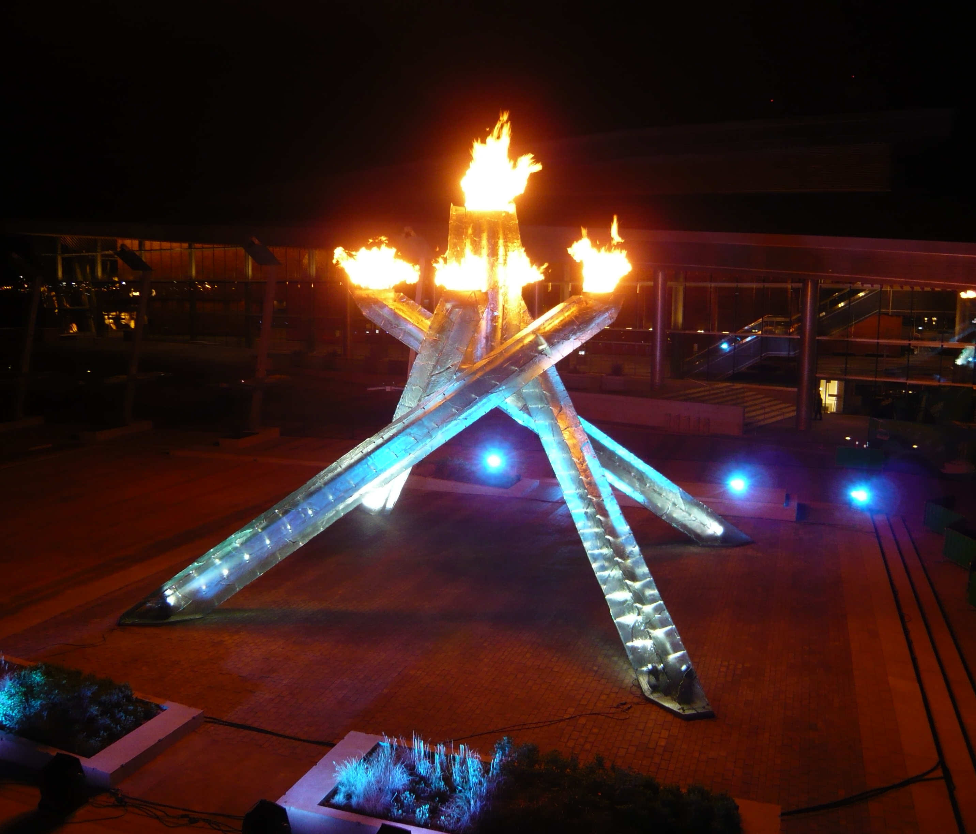
THANK YOU!

